Slide 1
Partnership Access Line
PAL-PAK
Donna Reisinger
dreisinger@a2p2.org (907) 313-4643
Communications & Training Coordinator
Help Me Grow Alaska - All Alaska Pediatric Partnership
Seattle Children’s Hospital
In Collaboration with Help Me Grow - Alaska
AKST

Slide 2
What is PAL-PAK?
Free psychiatric care conferences
  2 times a year in AK
Free, expert reviewed care guide for providers at seattlechildrens.org/palpak
Quarterly fidelity audits and team consult approach to ensure consistent care

Slide 3

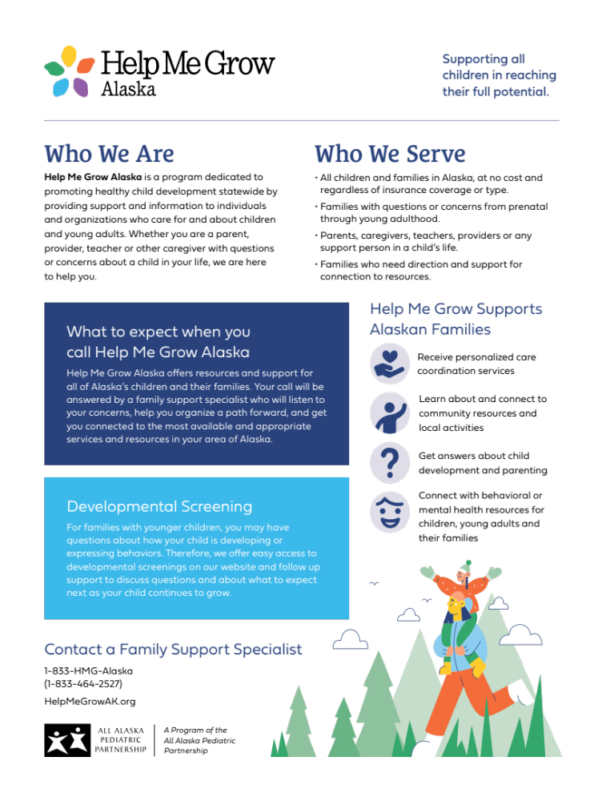
What is Help Me Grow Alaska?
Help Me Grow Alaska (HMG-AK) is a program of the All Alaska Pediatric Partnership. It is dedicated to healthy child development statewide by providing support and information to individuals and organizations who care for and about children and young adults.
We help connect families, caregivers, providers, and agencies with local resources available in their community.
HMG-AK helps to coordinate the PAL-PAK program with the State of Alaska’s Division of Behavioral Health and Seattle Children’s.

Slide 4
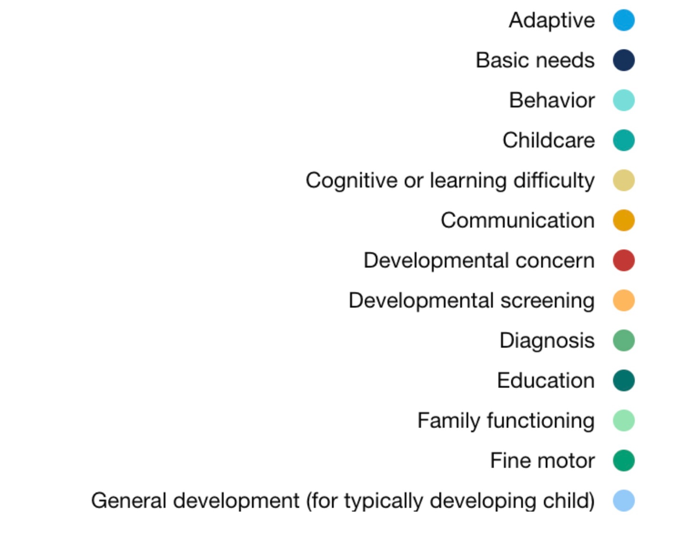
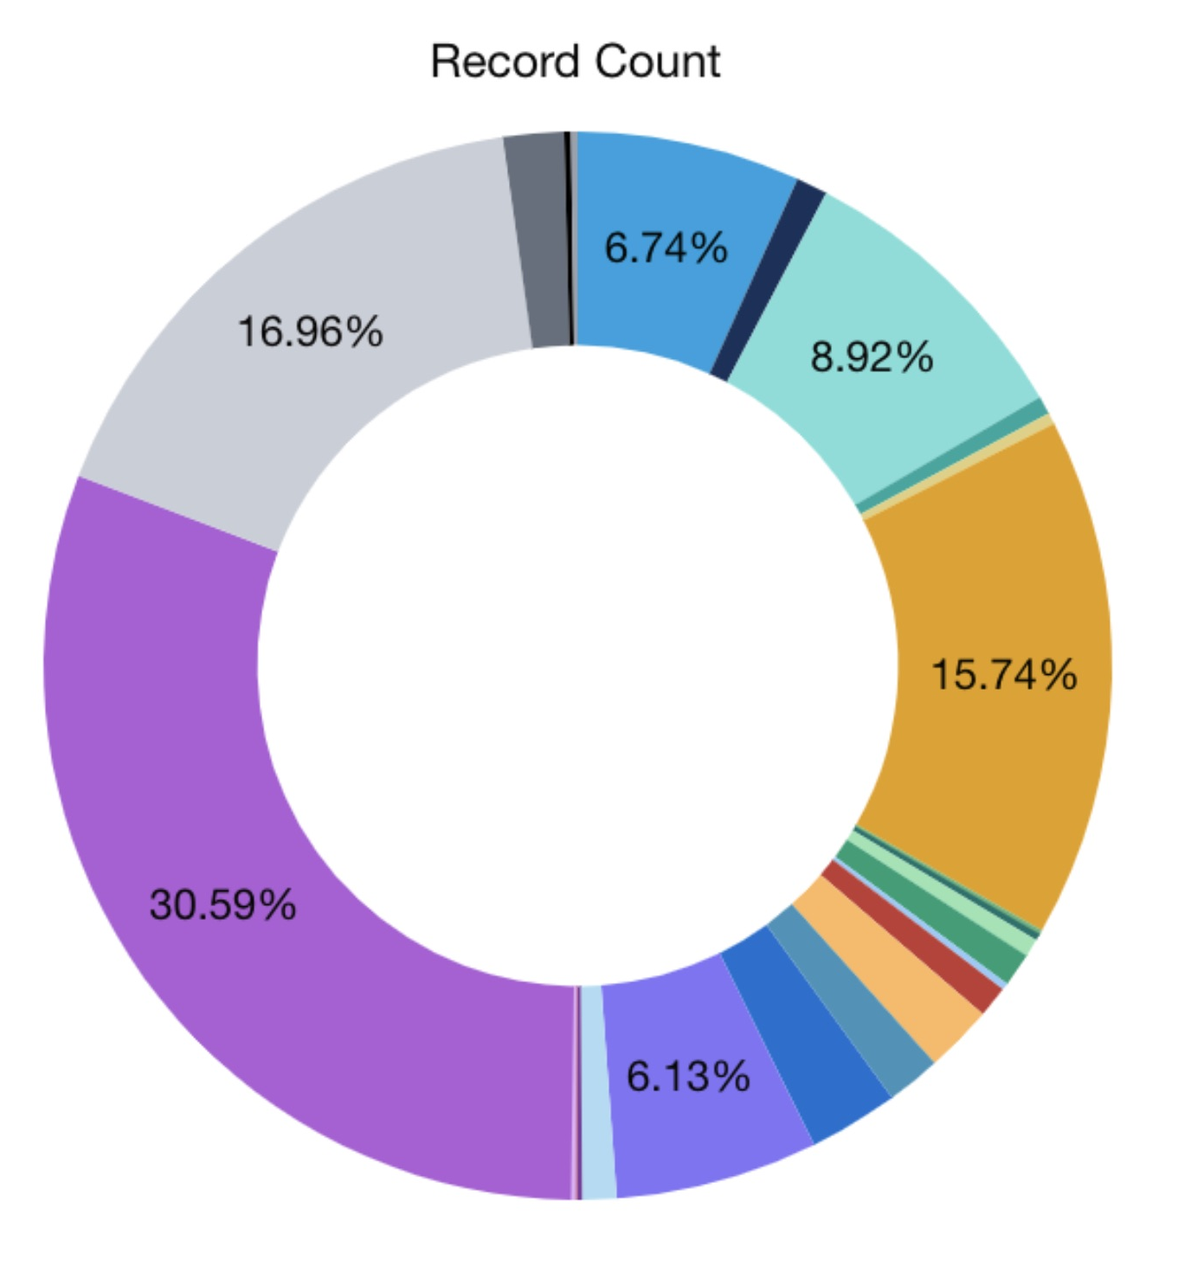
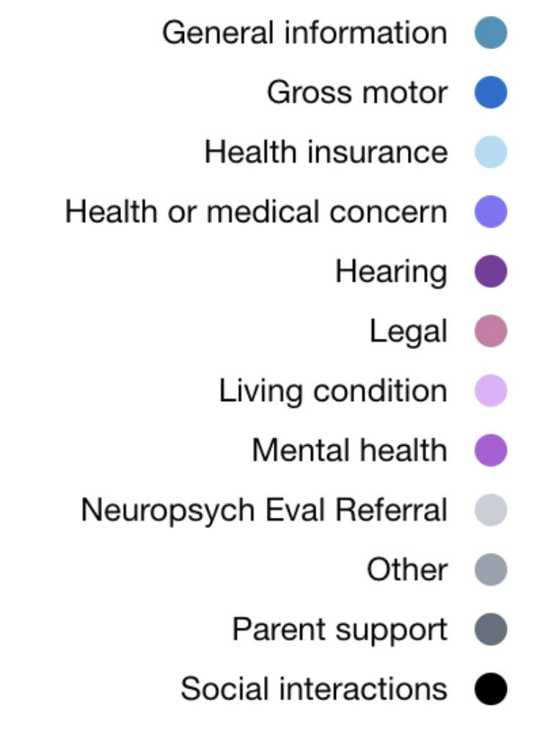
Primary Reason for HMG-AK Call 2023
8.92%
*The information on this slide is from the Help Me Grow Alaska (HMG-AK) program. HMG-AK works in partnership with PAL-PAK to help navigate additional supports that families may need outside of the original provider.
This slide is intended to highlight the need for support in the mental health care area. HMG-AK services the entire state of Alaska.
15.74%
30.59%
16.96%

Slide 5
PAL-PAK Process

Slide 6
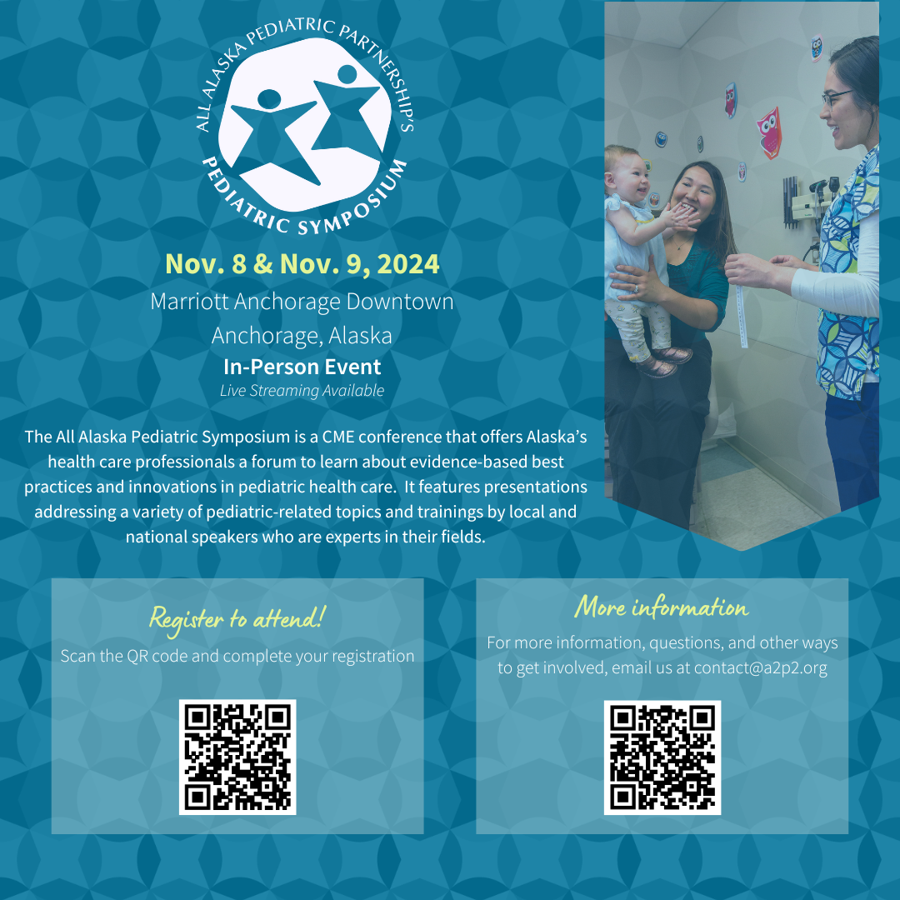
Upcoming All Alaska Pediatric Symposium

Slide 7
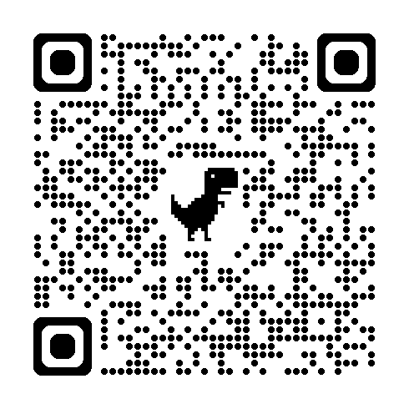
PAL-PAK Partners
PAL-PAK Website

