Slide 1

Help Me Grow Alaska
Connecting Alaskan Children and Families to Resources and Support
Elizabeth Schultz
Community Relations Manager
All Alaska Pediatric Partnership, A2P2
A program of the

Slide 2

All Alaska Pediatric Partnership
Core Purpose:
Excellent health for all of Alaska’s children
Core Values:
Driving Excellence
Innovation
Partnerships
Systems Approach
Close to Home
Core Programs:
Quality Improvement
Convening & Connecting
Avenue for Best Practices
Systems Change
Advocacy/Public Policy/Education

Slide 3
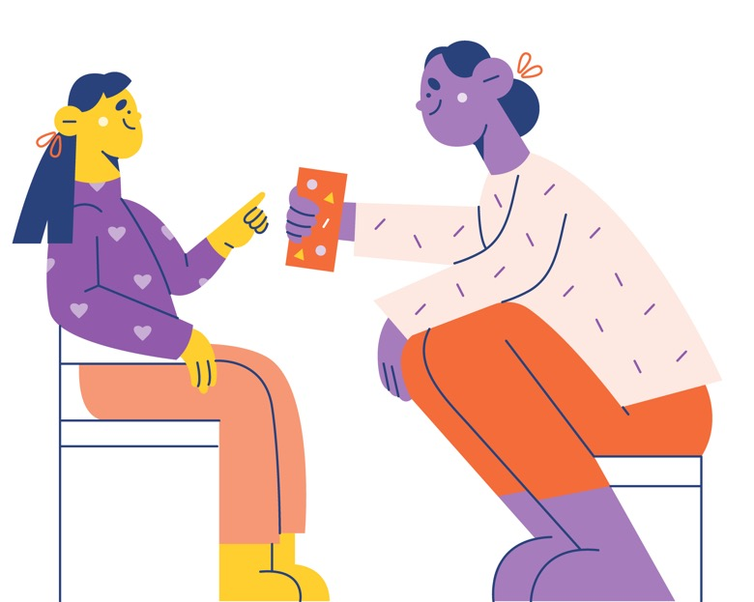

PAL-PAK
Partnership Access Line – Pediatric Alaska
Seattle Children’s Hospital in Collaboration with Help Me Grow Alaska
Monday – Friday 7am to 4pm AKST
www.seattlechildrens.org/PALPAK

Slide 4
Partnership Access Line - Pediatric AK
(PAL-PAK)
Who: The PAL team consists of child and adolescent psychiatrists affiliated with the University of Washington School of Medicine and Seattle Children’s Hospital. Seattle Children’s has five full-time staff, ten total, on this dedicated team.
What: PAL-PAK psychiatrists are available to any medication-prescriber in Alaska with questions about mental health care (for example: medication adjustment, treatment planning or diagnostic clarification). The phone consultation is covered by HIPPA, section 45 CFR 164.506, no additional release of information is required to consult about a patient.
How: PAL-PAK psychiatrists are available via telephone M-F from 7 a.m. to 4 p.m. AKST. There is an 85% live answer rate of talking to a Psychiatrist on first call. If a psychiatrist is not available, another PAL team member will schedule a time to talk.
Notes:
Help Me Grow Alaska helps to coordinate the Partnership Access Line - Pediatric Alaska (PAL-PAK) Program. PAL-PAK is a partnering program with the Division of Behavioral Health and Seattle Children’s Hospital, and offers free access to a child psychiatry consult line through the Partnership Access Line at Seattle Children’s Hospital. This is a program for any medication-prescribing providers who work with children.

Slide 6


To talk with a PAL-PAK Psychiatrist, call (855) 599-7257.
More information can be found on the PAL-PAK website at www.seattlechildrens.org/PALPAK
Link to 5-minute PAL-PAK promotional video here: https://vimeo.com/589402842

